Slide 1
Innisfree Village
Robert, Bethany, Will, Xavier, Zoe, and Domenic

Slide 2
Innisfree Village
“A lifesharing community with adults with disabilities”
The village has several homes where residents and volunteers live together
They spend their days doing work that helps to sustain the village
Workstations: gardening, carpentry, baking, and weaving
Residents have complex medical needs and have many appointments
Shared cars are used to take residents to the doctor
All of this (making appointments and taking out cars) is scheduled with Excel and a paper calendar...

Slide 3
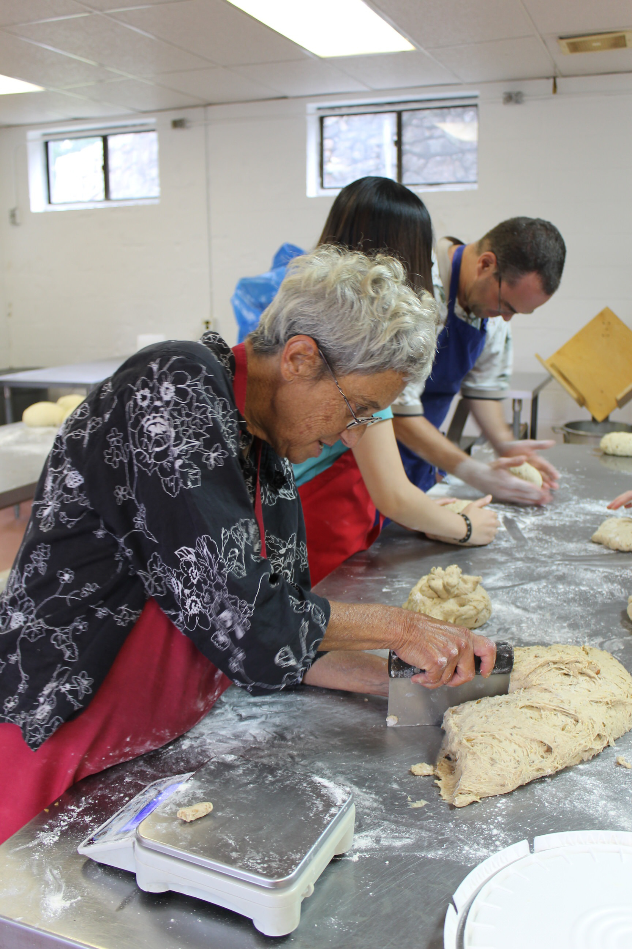
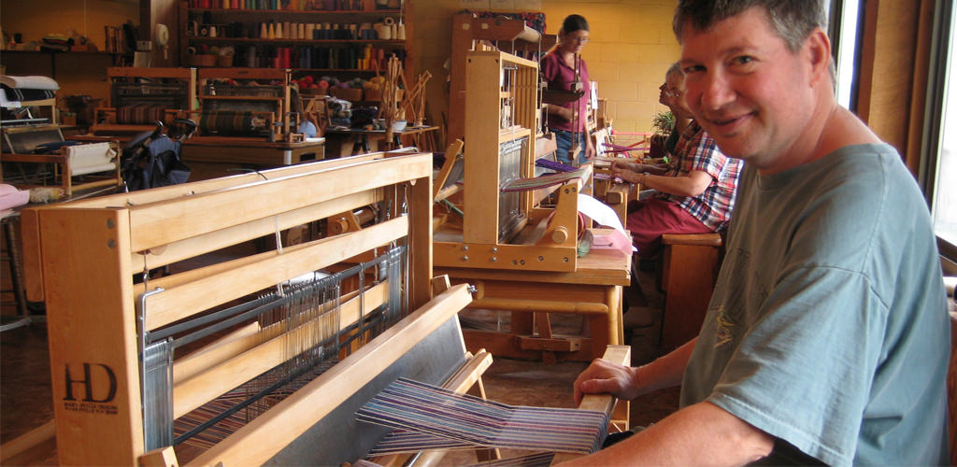
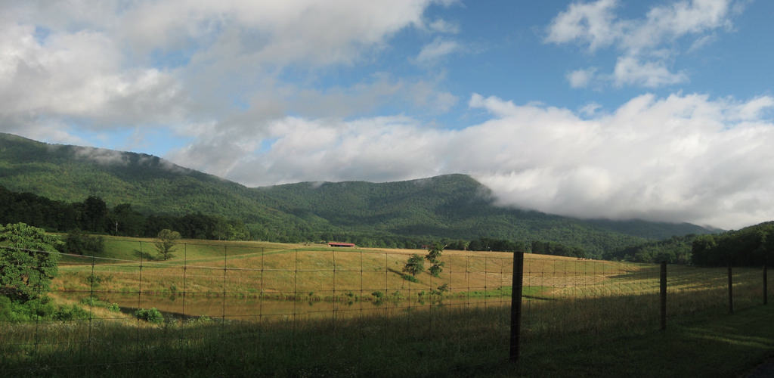

Slide 4
Our Goals
Major Requirements
Web portal with user levels
Appointment scheduling
Notifications to volunteers
Report generation
Desired Requirements
Mobile interface
Car sign-out

Slide 5


Our System
Ruby on Rails!

Slide 6
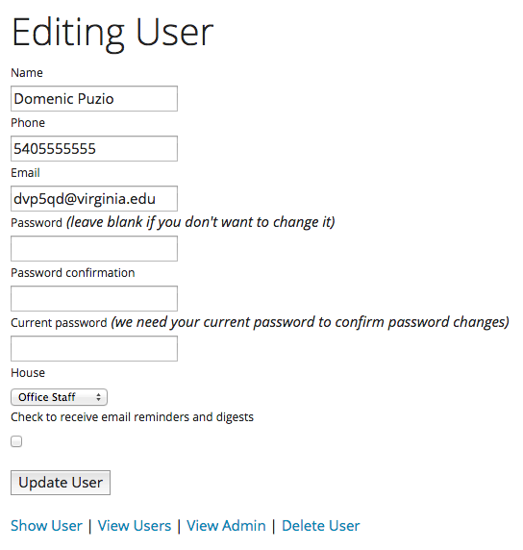
Web Portal
User accounts
Need to set and reset
passwords
Three levels of access
Office staff (administrators)
Volunteers
Workstation heads

Slide 7
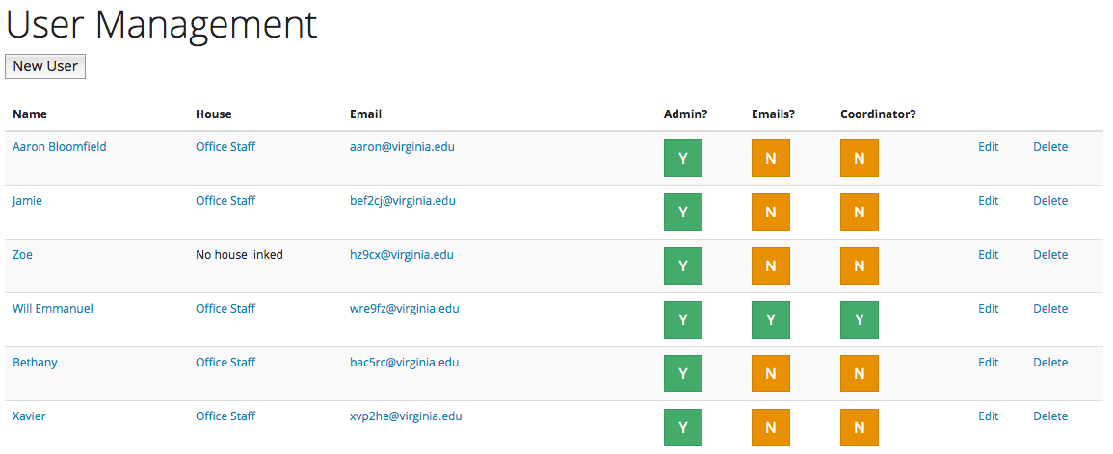
Web Portal

Slide 8
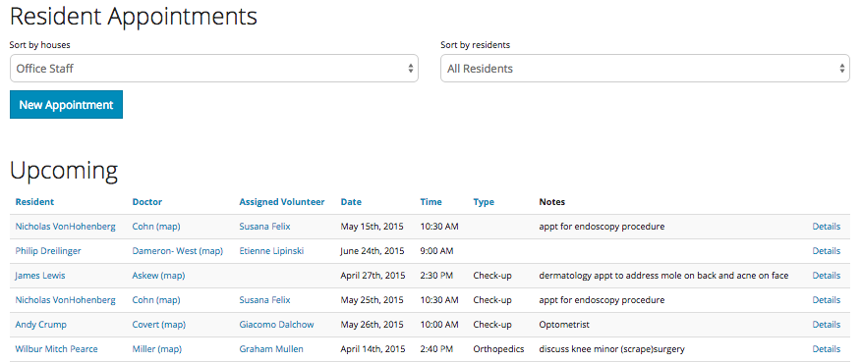
Scheduling Appointments

Slide 9
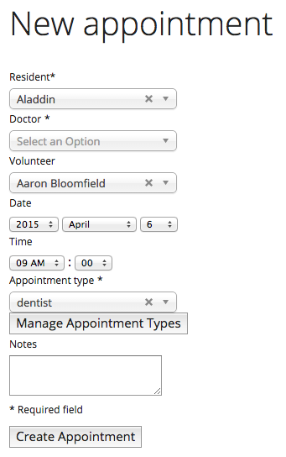
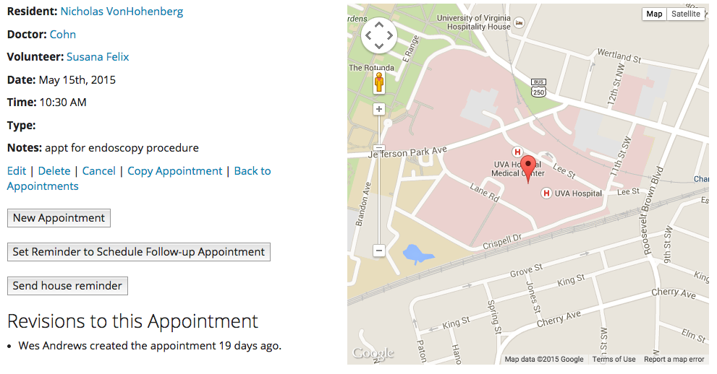
Scheduling Appointments

Slide 10
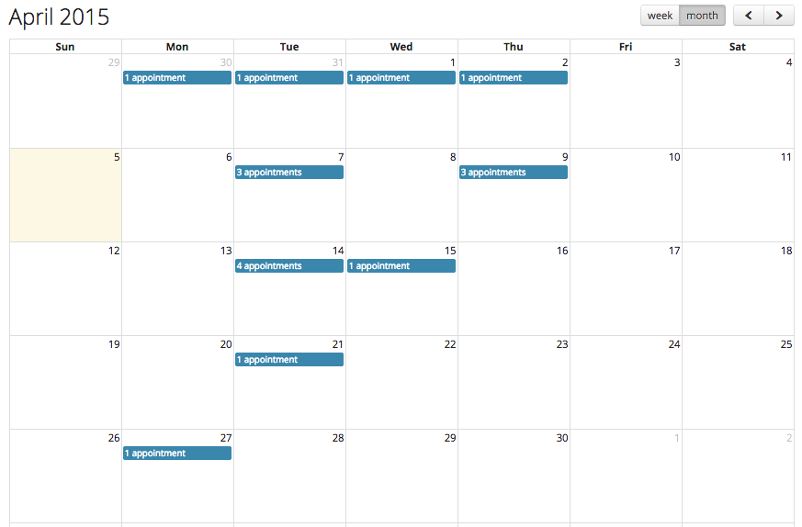
Scheduling Appointments

Slide 11
Volunteer Notifications
Lots of emails
Weekly and daily appointment digests
Reminders to schedule future appointments
Button to remind assigned volunteers
Filtered to only show relevant appointments
This requirement changed… a lot
As we added more, they realized more that they wanted

Slide 12
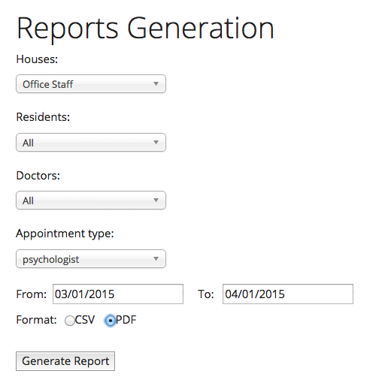
Report Generation
Look at all appointment data with
relevant filters
Time range
Specific resident
Appointment type
Specific doctor
CSV and PDF formats
Evolved as system developed
Our systems is really good at
tracking everything that is
going on

Slide 13
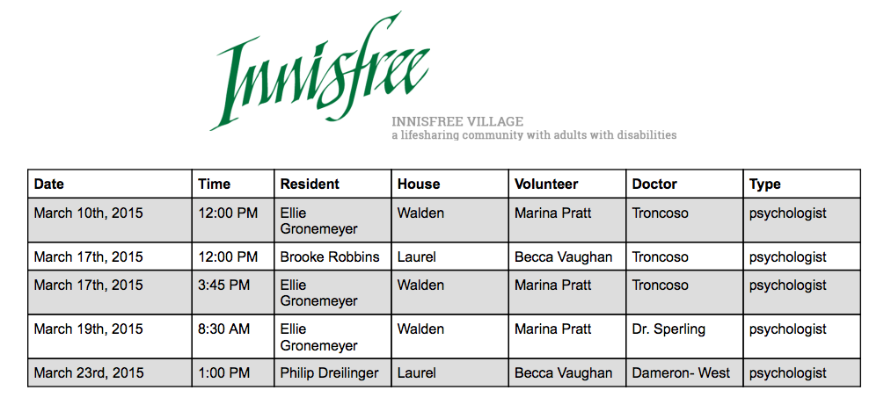
Report Generation

Slide 14
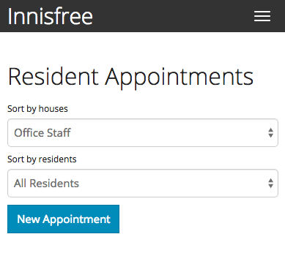
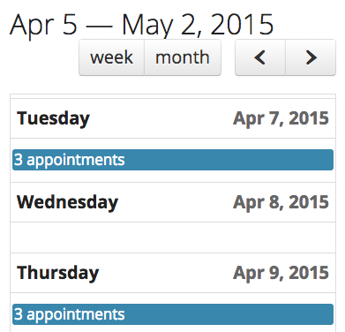
Mobile Interface

Slide 15
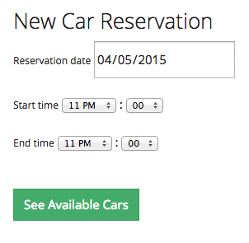
Car Sign-Out
Select date and time range to see
what is available
Can update reservations on the fly
for unexpected changes
Manage cars to add and delete cars

Slide 16
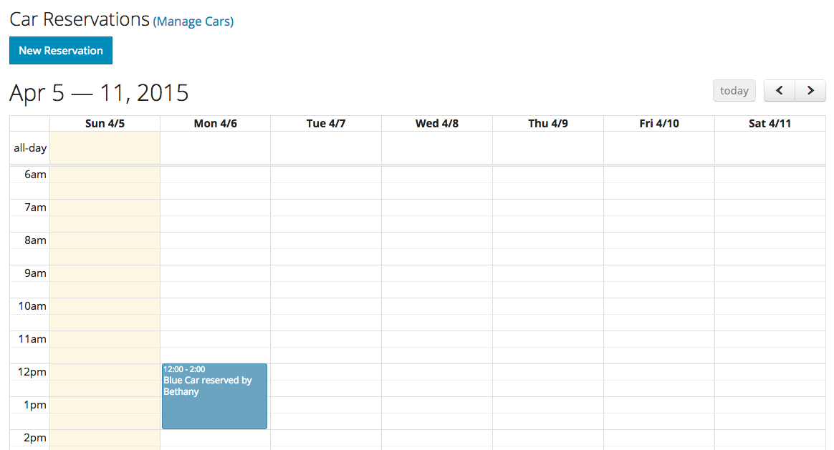
Car Sign-Out

Slide 17
Wrapping Up
Customers are no longer…
heading to the central office whenever they want to make an appointment or sign out a car
calling from the doctor’s office to see when the schedule is open
leaving annoying paper reminders for each other
(now they’re sending annoying emails)
Challenges
Not everyone has a smartphone
Wifi is still being implemented
All development goals were met

